Slide 1
Game Playing

Slide 2
The Game
In which we examine the problems that arise when we try to plan ahead in a world that includes a hostile agent
The presence of an opponent makes the decision problem somewhat more complicated than the search problems.
A game can be defined by the initial state (how the board is set up), the operators (which define the legal moves), a terminal test (which says when the game is over), and a utility or payoff function (which says who won, and by how much)

Slide 3
Why study games
Fun
Clear criteria for success
Offer an opportunity to study problems involving {hostile, adversarial, competing} agents.
Interesting, hard problems which require minimal “initial structure”
Games often define very large search spaces
  chess 35^100 nodes in search tree, 10^40 legal states
Historical reasons
Different from games studied in game theory

Slide 4
Typical Case (perfect games)
2-person game
Players alternate moves
Zero-sum-- one players loss is the other’s gain.
Perfect information -- both players have access to complete information about the state of the game. No information is hidden from either player.
No chance (e.g., using dice) involved
Clear rules for legal moves (no uncertain position transition involved)
Well-defined outcomes (W/L/D)
Examples: Tic-Tac-Toe, Checkers, Chess, Go, Nim, Othello
Not: Bridge, Solitaire, Backgammon, ...

Slide 5
How to play a game
A way to play such a game is to:
  Consider all the legal moves you can make.
  Each move leads to a new board configuration (position).
  Evaluate each resulting position and determine which is best
  Make that move.
  Wait for your opponent to move and repeat?
Key problems are:
  Representing the “board”
  Generating all legal next boards
  Evaluating a position
  Look ahead

Slide 6
Game Trees
Problem spaces for typical games represented as trees.
Root node represents the “board” configuration at which a decision must be made as to what is the best single move to make next. (not necessarily the initial configuration)
Evaluator function rates a board position. f(board) (a real number).
Arcs represent the possible legal moves for a player (no costs associated to arcs)
Terminal nodes represent end-game configurations (the result must be one of “win”, “lose”, and “draw”, possibly with numerical payoff)

Slide 7
If it is my turn to move, then the root is labeled a "MAX" node; otherwise it is labeled a "MIN" node indicating my opponent's turn.
Each level of the tree has nodes that are all MAX or all MIN; nodes at level i are of the opposite kind from those at level i+1
Complete game tree: includes all configurations that can be generated from the root by legal moves (all leaves are terminal nodes)
Incomplete game tree: includes all configurations that can be generated from the root by legal moves to a given depth (looking ahead to a given steps)

Slide 8
Evaluation Function
Evaluation function or static evaluator is used to evaluate the "goodness" of a game position.
  Contrast with heuristic search where the evaluation function was a non-negative estimate of the cost from the start node to a goal and passing through the given node.
The zero-sum assumption allows us to use a single evaluation function to describe the goodness of a board with respect to both players.
  f(n) > 0: position n good for me and bad for you.
  f(n) < 0: position n bad for me and good for you
  f(n) near 0: position n is a neutral position.
  f(n) >> 0: win for me.
  f(n) << 0: win for you..

Slide 9
Evaluation function is a heuristic function, and it is where the domain experts’ knowledge resides.
Example of an Evaluation Function for Tic-Tac-Toe:
  f(n) = [# of 3-lengths open for me] - [# of 3-lengths open for you]
  where a 3-length is a complete row, column, or diagonal.
Alan Turing’s function for chess
  f(n) = w(n)/b(n) where w(n) = sum of the point value of white’s pieces and b(n) is sum for black.
Most evaluation functions are specified as a weighted sum of position features:
  f(n) = w1*feat1(n) + w2*feat2(n) + ... + wn*featk(n)
Example features for chess are piece count, piece placement, squares controlled, etc.
Deep Blue has about 6,000 features in its evaluation function.

Slide 10
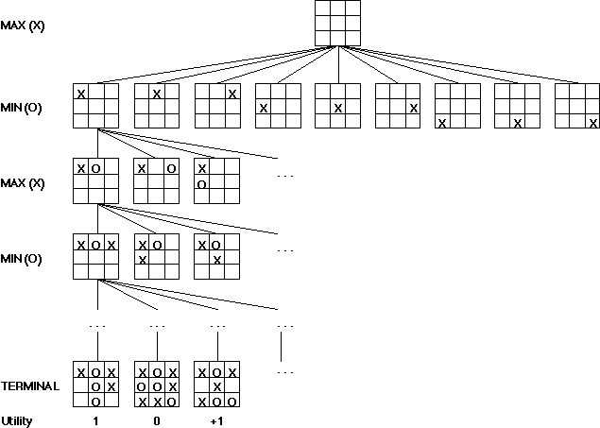
An example (partial) game tree for Tic-Tac-Toe
f(n) = +1 if the position is a win for X.
f(n) = -1 if the position is a win for O.
f(n) = 0 if the position is a draw.
-

Slide 11
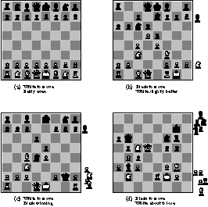
Some Chess Positions and their Evaluations

Slide 12
In two-player games with perfect information, the
minmax algorithm can determine the best move for a
player (assuming the opponent plays perfectly) by
determining the entire game tree

Slide 13
Minimax Rule
Goal of game tree search: to determine one move for Max player that maximizes the guaranteed payoff for a given game tree for MAX
  Regardless of the moves the MIN will take
The value of each node (Max and MIN) is determined by (back up from) the values of its children
MAX plays the worst case scenario:
  Always assume MIN to take moves to maximize his pay-off (i.e., to minimize the pay-off of MAX)
For a MAX node, the backed up value is the maximum of the values associated with its children
For a MIN node, the backed up value is the minimum of the values associated with its children

Slide 14
Minimax procedure
Create start node as a MAX node with current board configuration
Expand nodes down to some depth (i.e., ply) of lookahead in the game.
Apply the evaluation function at each of the leaf nodes
Obtain the “back up" values for each of the non-leaf nodes from its children by Minimax rule until a value is computed for the root node.
Pick the operator associated with the child node whose backed up value determined the value at the root as the move for MAX

Slide 15
Minimax Search
2
2
1
2
1
2
7
1
8
2
7
1
8
2
7
1
8
This is the move
selected by minimax
2
Static evaluator
value
2
1
MAX
MIN
2
7
1
8

Slide 16
Comments on Minimax search
The search is depth-first with the given depth (ply) as the limit
  Time complexity: O(b^d)
  Linear space complexity
Performance depends on
  Quality of evaluation functions (domain knowledge)
  Depth of the search (computer power and search algorithm)
Different from ordinary state space search
  Not to search for a solution but for one move only
  No cost is associated with each arc
  MAX does not know how MIN is going to counter each of his moves
Minimax rule is a basis for other game tree search algorithms

Slide 17
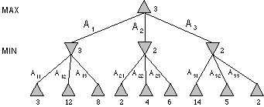
Minimax Tree
MAX node
MIN node
value computed
by minimax
f value

Slide 18
The alpha-beta algorithm does the same calculation as
Minmax but is more efficient because it prunes (allows
us to ignore portions of the search tree that make no
difference to the final choice) away branches of the
search tree that it can prove are irrelevant to the
final outcome.

Slide 19
Alpha-beta pruning
We can improve on the performance of the minimax algorithm through alpha-beta pruning.
Basic idea: “If you have an idea that is surely bad, don't take the time to see how truly awful it is.” -- Pat Winston
>=2
We don’t need to compute the value at this node.
No matter what it is it can’t effect the value of the root node.
=2
<=1
2
7
1
?

Slide 20
Alpha-beta pruning
Traverse the search tree in depth-first order
At each Max node n, alpha(n) = maximum value found so far
  Start with -infinity and only increase
  Increases if a child of n returns a value greater than the current alpha
  Serve as a tentative lower bound of the final pay-off
At each Min node n, beta(n) = minimum value found so far
  Start with infinity and only decrease
  Decreases if a child of n returns a value less than the current beta
  Serve as a tentative upper bound of the final pay-off
beta(n) for MAX node n: smallest beta value of its MIN ancestors
alpha(n) for MIN node n: greatest alpha value of its MMAX ancestors

Slide 21
Alpha-beta pruning
Carry alpha and beta values down during search
  alpha can be changed only at MAX nodes
  beta can be changed only at MIN nodes
  Pruning occurs whenever alpha >= beta
alpha cutoff:
  Given a Max node n, cutoff the search below n (i.e., don't generate any more of n's children) if alpha(n) >= beta(n)
  (alpha increases and passes beta from below)
beta cutoff:
  Given a Min node n, cutoff the search below n (i.e., don't generate any more of n's children) if beta(n) <= alpha(n)
  (beta decreases and passes alpha from above)

Slide 22
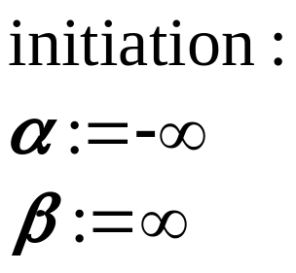
Alpha-beta algorithm
Two functions recursively call each other
  function MAX-value (n, alpha, beta)
  if n is a leaf node then return f(n);
  for each child n’ of n do
  alpha :=max{alpha, MIN-value(n’, alpha, beta)};
  if alpha >= beta then return beta /* pruning */
  end{do}
  return alpha
  function MIN-value (n, alpha, beta)
  if n is a leaf node then return f(n);
  for each child n’ of n do
  beta :=min{beta, MAX-value(n’, alpha, beta)};
  if beta <= alpha then return alpha /* pruning */
  end{do}
  return beta

Slide 23
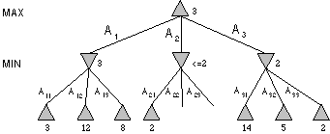
Alpha-beta search

Slide 24






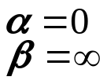
An example of Alpha-beta pruning
0
max
min
0
0
max
0
min
0
-3
0
-3
3
max
0
5
-3
3
3
-3
0
2
-2
3

Slide 25

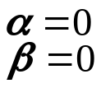
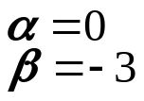
Final tree
max
min
max
min
max
0
5
-3
3
3
-3
0
2
-2
3

Slide 26
Effectiveness of Alpha-beta pruning
Alpha-Beta is guaranteed to compute the same value for the root node as computed by Minimax.
Worst case: NO pruning, examining O(b^d) leaf nodes, where each node has b children and a d-ply search is performed
Best case: examine only O(b^(d/2)) leaf nodes.
  You can search twice as deep as Minimax! Or the branch factor is b^(1/2) rather than b.
Best case is when each player's best move is the leftmost alternative, i.e. at MAX nodes the child with the largest value generated first, and at MIN nodes the child with the smallest value generated first.
In Deep Blue, they found empirically that Alpha-Beta pruning meant that the average branching factor at each node was about 6 instead of about 35-40

Slide 27
Assignment
Read Section 5.1- 5.6

Slide 28
Optional

Slide 29
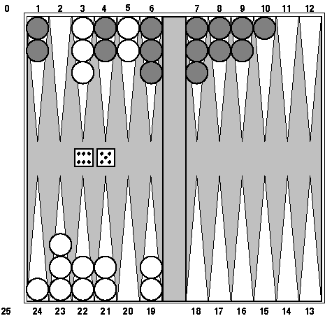
Games of Chance
Backgammon is a two player game with uncertainty.
Players roll dice to determine what moves to make.
White has just rolled 5 and 6 and had four legal moves:
  5-10, 5-11
  5-11, 19-24
  5-10, 10-16
  5-11, 11-16
Such games are good for exploring decision making in adversarial problems involving skill and luck.

Slide 30
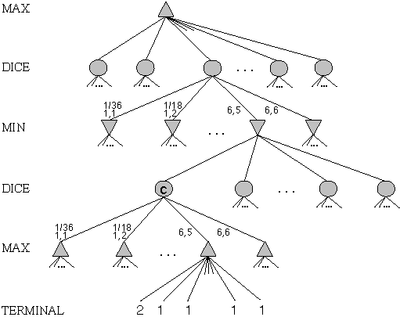
Game Trees with Chance Nodes
Chance nodes (shown as circles) represent the dice rolls.
Each chance node has 21 distinct children with a probability associated with each.
We can use minimax to compute the values for the MAX and MIN nodes.
Use expected values for chance nodes.
For chance nodes over a max node, as in C, we compute:
epectimax(C) = Sum_{i}(P(d_{i}) * maxvalue(i))
For chance nodes over a min node compute:
epectimin(C) = Sum_{i}(P(d_{i}) * minvalue(i))
Min
Rolls
Max
Rolls

Slide 31
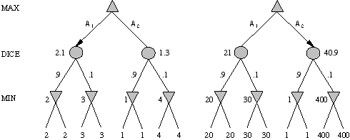
Meaning of the evaluation function
A1 is best move
A2 is best move
2 outcomes with prob {.9, .1}
Dealing with probabilities and expected values means we have to be careful about the “meaning” of values returned by the static evaluator.
Note that a “relative-order preserving” change of the values would not change the decision of minimax, but could change the decision with chance nodes.
Linear transformations are ok

Slide 32
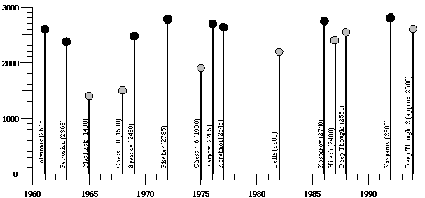
Ratings of Human and Computer Chess Champions

Slide 33
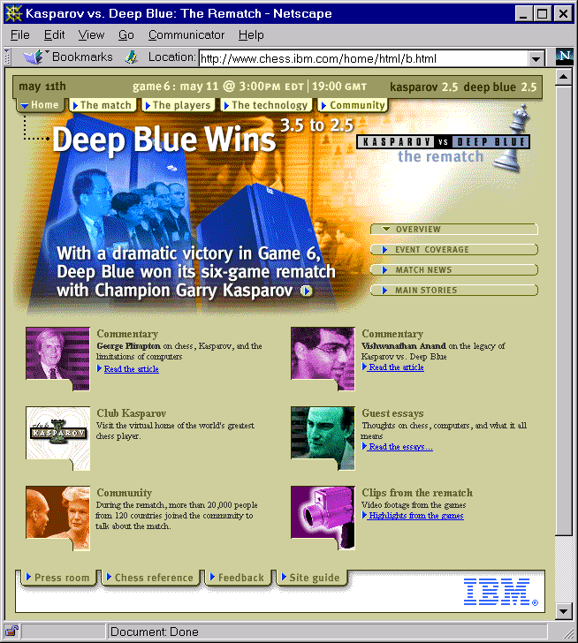

Slide 34
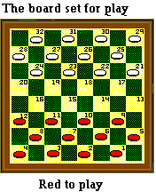

Chinook
Chinook is the World Man-Machine Checkers Champion developed by researchers at the University of Alberta.
It earned this title by competing in human tournaments, winning the right to play for the (human) world championship, and eventually defeating the best players in the world.
Visit <http://www.cs.ualberta.ca/~chinook/> to play Chinook over the Internet.
Read “One Jump Ahead: Challenging Human Supremacy in Checkers” Jonathan Schaeffer, University of Alberta (496 pages, Springer. $34.95, 1998).

Slide 35
Assignment
Read the supplied soft copy on CSP

